Slide 1
IoT #Technology and Data Spring 2021
Zeev Yampolsky
Lior Degu

Slide 2
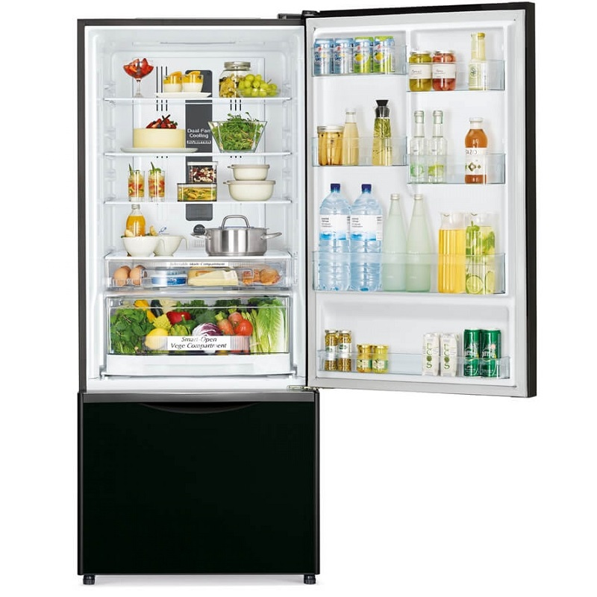
What’s the purpose of this project?
Design and build control and analysis
system for refrigerators
What have we used?
ESP32 SoC microcontroller - mandatory
BMP280 + TMP36 sensors - mandatory
LED + Photoresistor sensor - mandatory
Button - mandatory
OLED display - our implementation
Buzzer - our implementation

Slide 3
How this system work?

Slide 4
How this system work?

Slide 5
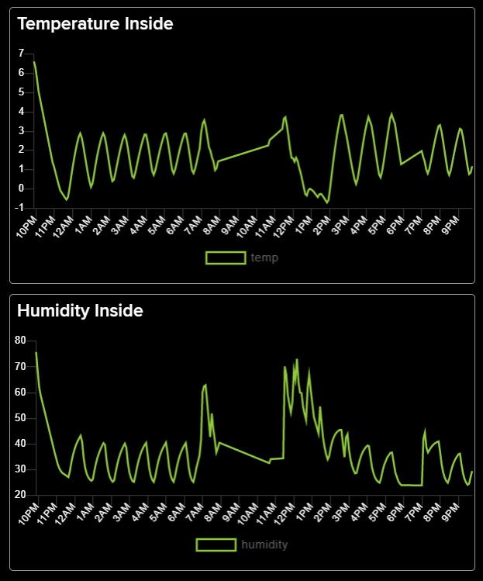
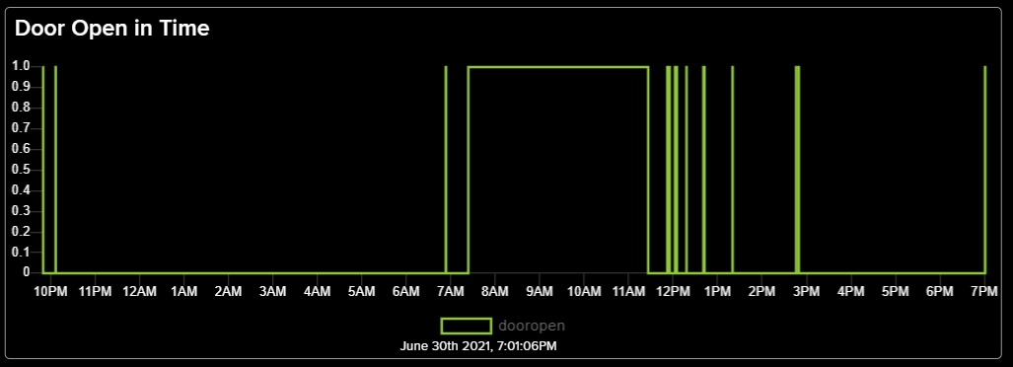
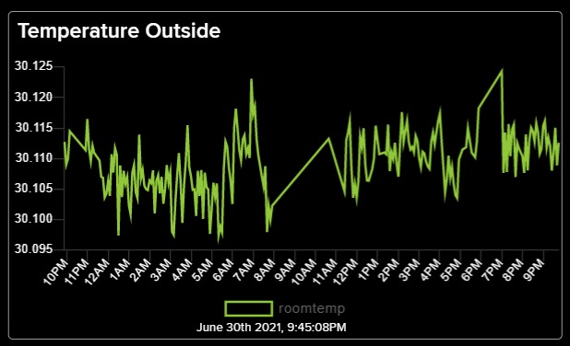
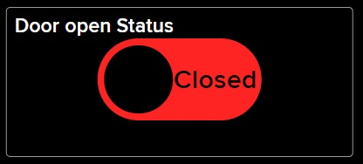
Data visualization Live dashboard

Slide 6

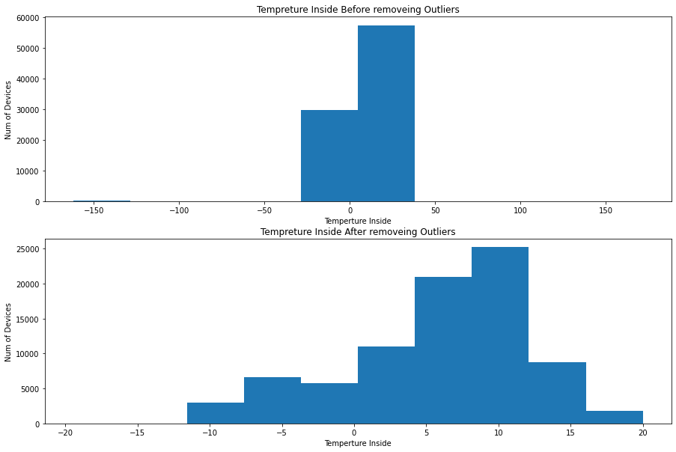
Data analysis

Slide 7
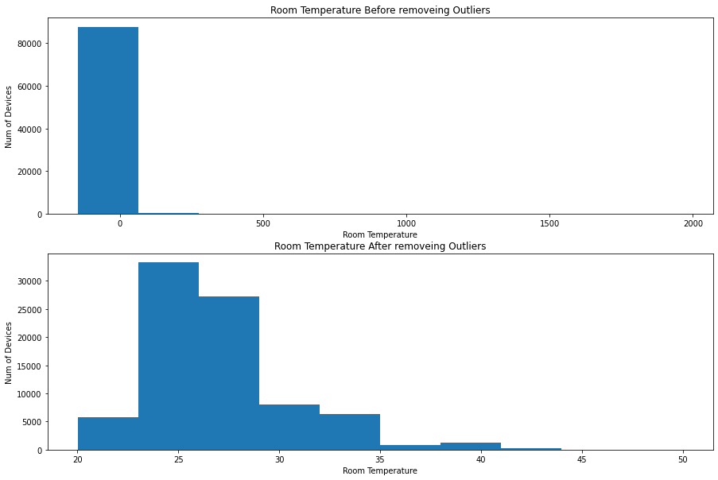
Data analysis

Slide 8
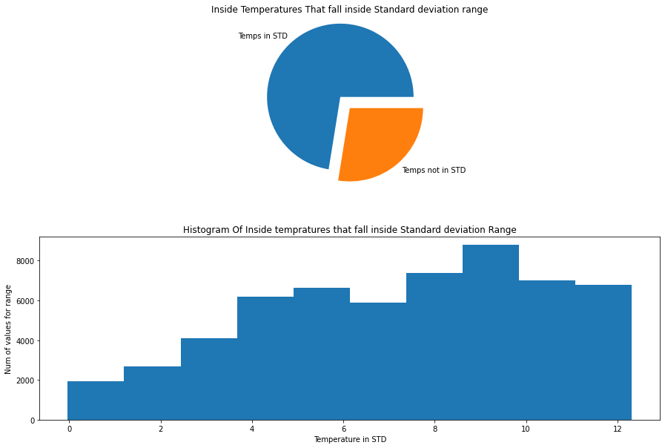
Data analysis

Slide 9
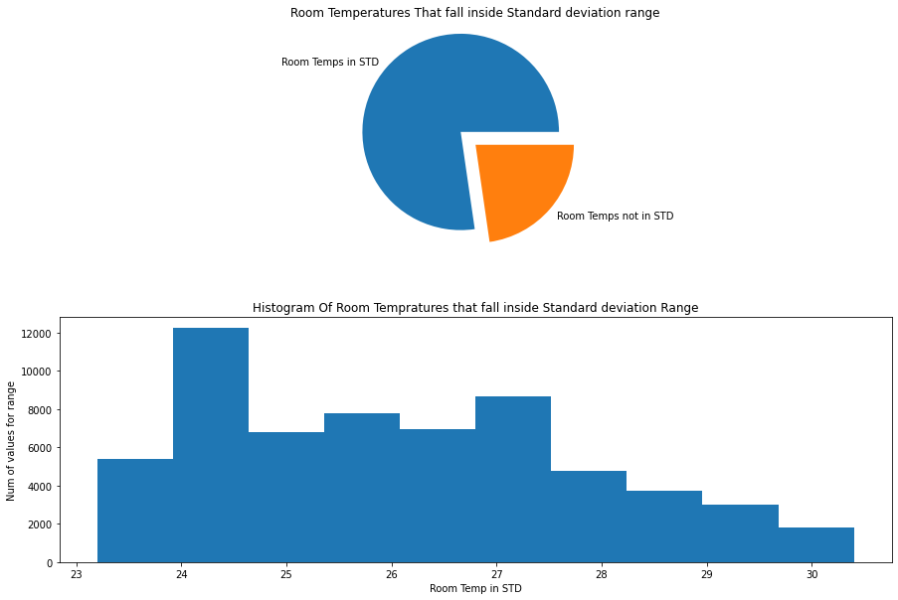
Data analysis

Slide 10
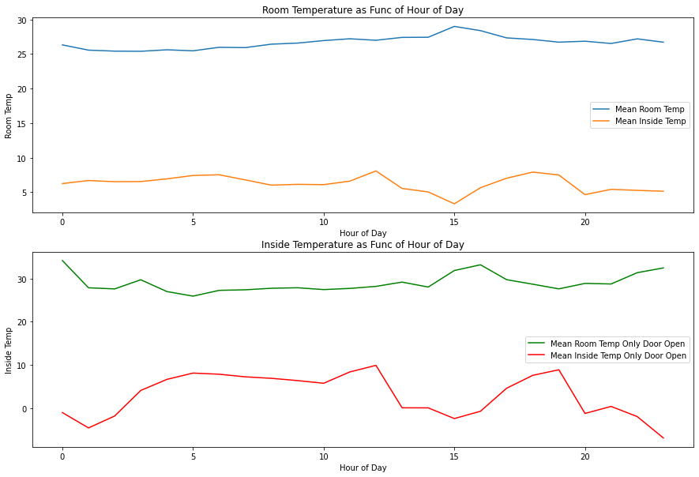
Data analysis

Slide 11
That’s it…
Thank you

